Slide 1
Midterm 2 Review
March 27, 2019

Slide 2
Coming up…
Problem Set 5 due today 11:55pm
Performance Assessment 5 due Sunday 11:55pm.
Lab Assignment due next Thursday 4/4.
Midterm 1 Review tomorrow in labs!
Midterm 1 Monday 4/1
  Feedback + Help
  Problem Set 4 already returned.
  Problem Set 5 TAs can give feedback in office hours.

Slide 3
Midterm 2
NEW Material Covered:
  Units 3.3, Unit 4, Unit 5
  Quasi-cumulative!
What to bring:
  Cheat sheet
    1 page (8.5’’ by 11’’)
    Front/back ok
    CAN be typed
  Calculator (no phones)
Provided:
  Z-tables
  T-tables
  Chi-Squared tables
Exam
  3 written questions (like AEs)
  5 T/F
  10 MC
1

Slide 4
Midterm 2 Review Suggestions
Short answer review:
  Make sure you understand how to do the application exercises.
  Review Problem Sets (graded)
Short answer practice:
  Tomorrow’s lab practice problem review
  Practice test
  Suggested practice problems in the book
1

Slide 5
Midterm 2 Short Answer Structure
Full Analysis
Determine which graphs might be appropriate for visualizing this original raw data
Determine which test is appropriate.
Set up hypotheses.
Check conditions.
Calculate test statistic
Calculate p-value
Interpret p-value/make conclusion in the context of the data.
Perhaps also calculate confidence intervals, and make other interpretations about things we do in the analysis.
1

Slide 6
Final Review Suggestions
Concept review:
  Lecture slides (has material not in the videos/book)
  Video notes
  Readiness Assessments+Performance Assessments
    Why are all the other options wrong?
  What to think about (among other things):
    Interpretations of analyses (WORDING IS IMPORTANT)
    Conclusions we would make (WORDING IS IMPORTANT)
    Equations
    Know exact definitions
    FOCUS ON THE WHY BEHIND ANALYSES
    If there’s an equation/analysis, make sure you know how to put that equation/analysis into words in the context of the problem.
    Conditions
    Common misconceptions (lecture notes)
    What test to use under certain conditions
1

Slide 7
How do MT1 material and MT2 material relate? Will MT1 material be on MT2?
MT1
Foundations for Inference
What does a p-value represent? How to put it in the context of the data.
How do we calculate a p-value with:
  The sampling distribution?
  A randomization distribution?
  A bootstrap distribution?
1

Slide 8
How do MT1 material and MT2 material relate? Will MT1 material be on MT2?
MT1
Foundations for Inference
What does a p-value represent? How to put it in the context of the data.
How do we calculate a p-value with:
  The sampling distribution?
  A randomization distribution?
  A bootstrap distribution?
When calculating a p-value with the following, what should they be centered at? What do they all need to assume?
  The sampling distribution?
  A randomization distribution?
  A bootstrap distribution?
1

Slide 9
How do MT1 material and MT2 material relate? Will MT1 material be on MT2?
MT1
Foundations for Inference
What does a p-value represent? How to put it in the context of the data.
How do we calculate a p-value with:
  The sampling distribution?
  A randomization distribution?
  A bootstrap distribution?
When calculating a p-value with the following, what should they be centered at? What do they all need to assume?
  The sampling distribution?
  A randomization distribution?
  A bootstrap distribution?
What does a confidence interval represent?
  How do we put it into words. “We are XX% confident that the true pop. Parameter is in the interval.”
  XX% of random samples of size n will have confidence interval that contains the pop. Parameter.
1

Slide 10
How do MT1 material and MT2 material relate? Will MT1 material be on MT2?
MT1
Foundations for Inference
What does a p-value represent? How to put it in the context of the data.
How do we calculate a p-value with:
  The sampling distribution?
  A randomization distribution?
  A bootstrap distribution?
When calculating a p-value with the following, what should they be centered at? What do they all need to assume?
  The sampling distribution?
  A randomization distribution?
  A bootstrap distribution?
What does a confidence interval represent?
  How do we put it into words. “We are XX% confident that the true pop. Parameter is in the interval.”
  XX% of random samples of size n will have confidence interval that contains the pop. Parameter.
Why is the Central Limit Theorem important?
  It tells us when a sampling distribution is normal.
  Remember properties of normal distributions!
1

Slide 11
How do MT1 material and MT2 material relate? Will MT1 material be on MT2? –Yes!
MT1
Foundations for Inference
Material after MT1
How do we specifically conduct inference for various combinations of numerical/categorical(2 vs. >2 levels) variables?
What does a p-value represent? How to put it in the context of the data.
How do we calculate a p-value with:
  The sampling distribution?
  A randomization distribution?
  A bootstrap distribution?
When calculating a p-value with the following, what should they be centered at? What do they all need to assume?
  The sampling distribution?
  A randomization distribution?
  A bootstrap distribution?
What does a confidence interval represent?
  How do we put it into words. “We are XX% confident that the true pop. Parameter is in the interval.”
  XX% of random samples of size n will have confidence interval that contains the pop. Parameter.
Why is the Central Limit Theorem important?
  It tells us when a sampling distribution is normal.
  Remember properties of normal distributions!
1

Slide 12
Conducting an Analysis… where to start?

Slide 13
Conducting an Analysis… where to start?
How many numerical and categorical variables are involved?
If categorical variables, how many levels do they have?
What visualization would be appropriate for visualizing this data?

Slide 14
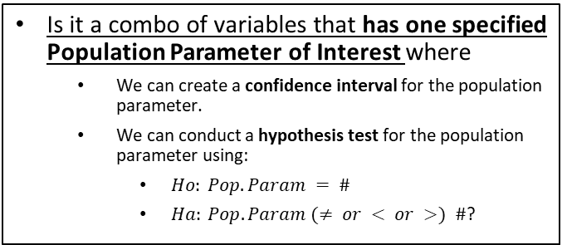
Conducting an Analysis… where to start?
How many numerical and categorical variables are involved?
If categorical variables, how many levels do they have?
What visualization would be appropriate for visualizing this data?
Is it a combo of variables that has one specified Population Parameter of Interest where
  We can create a confidence interval for the population parameter.
  We can conduct a hypothesis test for the population parameter using:
    $Ho: Pop. Param = \#$
    $Ha: Pop. Param (≠ or < or >) \#$?
Is it a combo of variables that doesn’t have one specified Population Parameter of Interest and
  We can’t make a confidence interval.
  Has a different hypothesis test set up?

Slide 15
Conducting an Analysis… where to start?
How many numerical and categorical variables are involved?
If categorical variables, how many levels do they have?
What visualization would be appropriate for visualizing this data?
Is it a combo of variables that has one specified Population Parameter of Interest where
  We can create a confidence interval for the population parameter.
  We can conduct a hypothesis test for the population parameter using:
    $Ho: Pop. Param = \#$
    $Ha: Pop. Param (≠ or < or >) \#$?
Is it a combo of variables that doesn’t have one specified Population Parameter of Interest and
  We can’t make a confidence interval.
  Has a different hypothesis test set up?
If we are making a confidence interval or hypothesis test for this population parameter, when should we use each of the following methods to do this?
  CLT methods
  Randomization testing methods
  Bootstrap methods

Slide 16
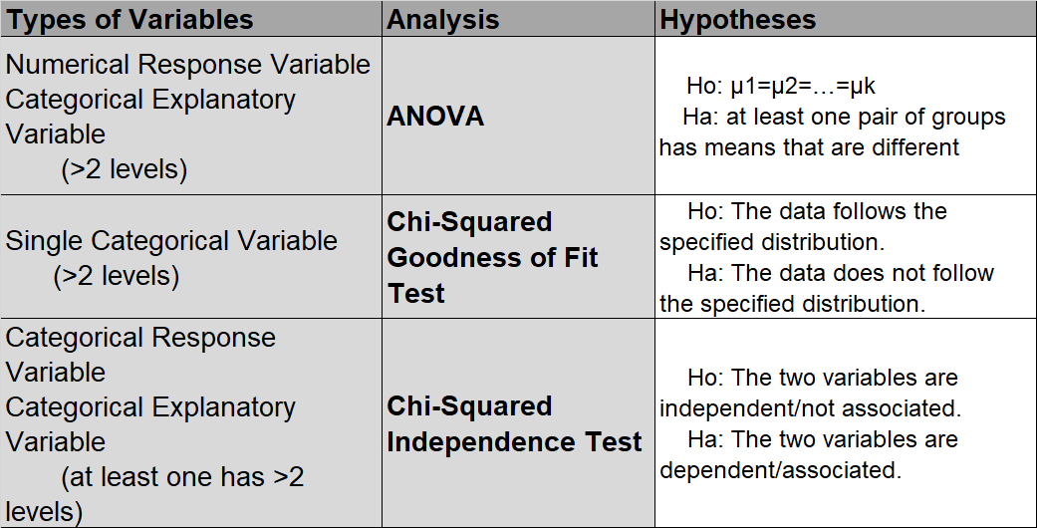
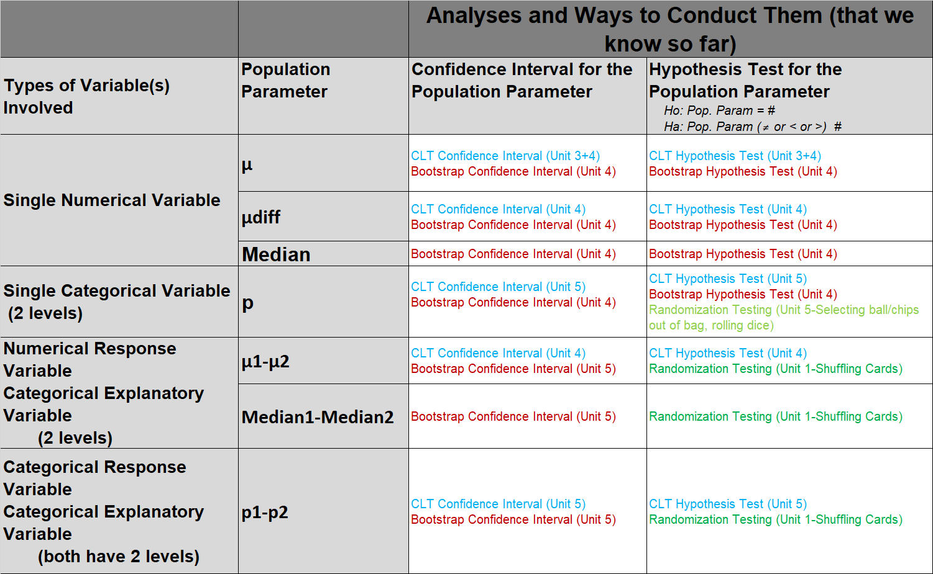
Conducting an Analysis… where to start?
How many numerical and categorical variables are involved?
If categorical variables, how many levels do they have?
What visualization would be appropriate for visualizing this data?
Is it a combo of variables that has one specified Population Parameter of Interest where
  We can create a confidence interval for the population parameter.
  We can conduct a hypothesis test for the population parameter using:
    $Ho: Pop. Param = \#$
    $Ha: Pop. Param (≠ or < or >) \#$?
Is it a combo of variables that doesn’t have one specified Population Parameter of Interest and
  We can’t make a confidence interval.
  Has a different hypothesis test set up?
If we are making a confidence interval or hypothesis test for this population parameter, when should we use each of the following methods to do this?
  CLT methods
  Randomization testing methods
  Bootstrap methods

Slide 17
Conducting an Analysis… where to start?
How many numerical and categorical variables are involved?
If categorical variables, how many levels do they have?
What visualization would be appropriate for visualizing this data?
Is it a combo of variables that has one specified Population Parameter of Interest where
  We can create a confidence interval for the population parameter.
  We can conduct a hypothesis test for the population parameter using:
    $Ho: Pop. Param = \#$
    $Ha: Pop. Param (≠ or < or >) \#$?
Is it a combo of variables that doesn’t have one specified Population Parameter of Interest and
  We can’t make a confidence interval.
  Has a different hypothesis test set up?
If we are making a confidence interval or hypothesis test for this population parameter, when should we use each of the following methods to do this?
  CLT methods (if CLT conditions met)
  Randomization testing methods (just for HT)
  Bootstrap methods

Slide 18
One Population Parameter of Interest

Slide 19
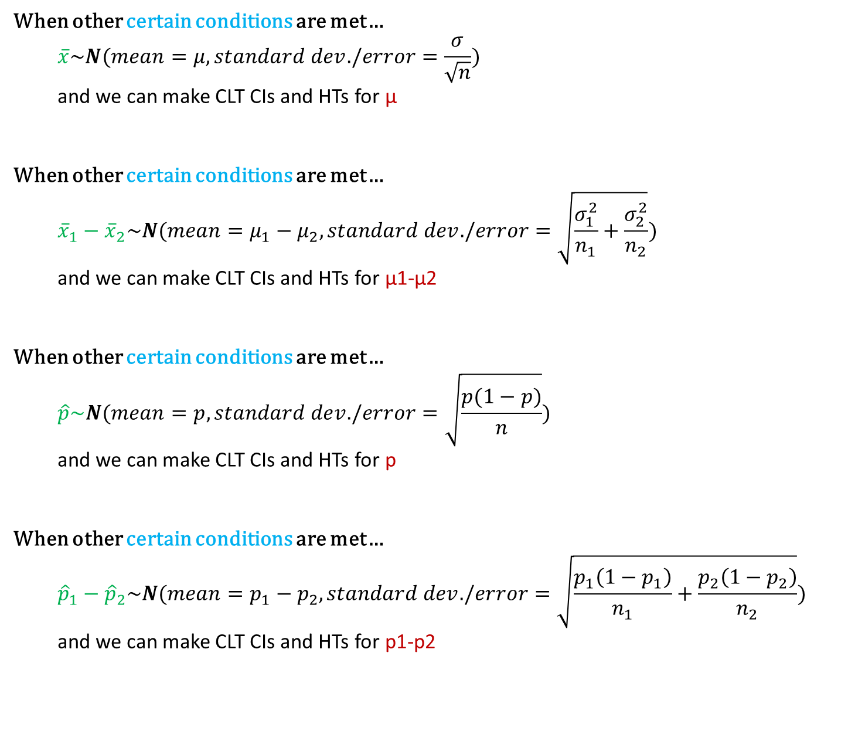
When other certain conditions are met…
  $$\overline{x}\sim N(mean=μ,standard dev./error=\frac{σ}{\sqrt{n}})$$
  and we can make CLT CIs and HTs for μ
When other certain conditions are met…
  $${\overline{x}}_{1}−{\overline{x}}_{2}\sim N(mean=μ_{1}−μ_{2},standard dev./error=\sqrt{\frac{σ_{1}^{2}}{n_{1}}+\frac{σ_{2}^{2}}{n_{2}}})$$
  and we can make CLT CIs and HTs for μ1-μ2
When other certain conditions are met…
  $$\hat{p}\sim N(mean=p,standard dev./error=\sqrt{\frac{p(1−p)}{n}})$$
  and we can make CLT CIs and HTs for p
When other certain conditions are met…
  $${\hat{p}}_{1}−{\hat{p}}_{2}\sim N(mean=p_{1}−p_{2},standard dev./error=\sqrt{\frac{p_{1}\left(1−p_{1}\right)}{n_{1}}+\frac{p_{2}\left(1−p_{2}\right)}{n_{2}}})$$
  and we can make CLT CIs and HTs for p1-p2
What are these CLT conditions?

Slide 20
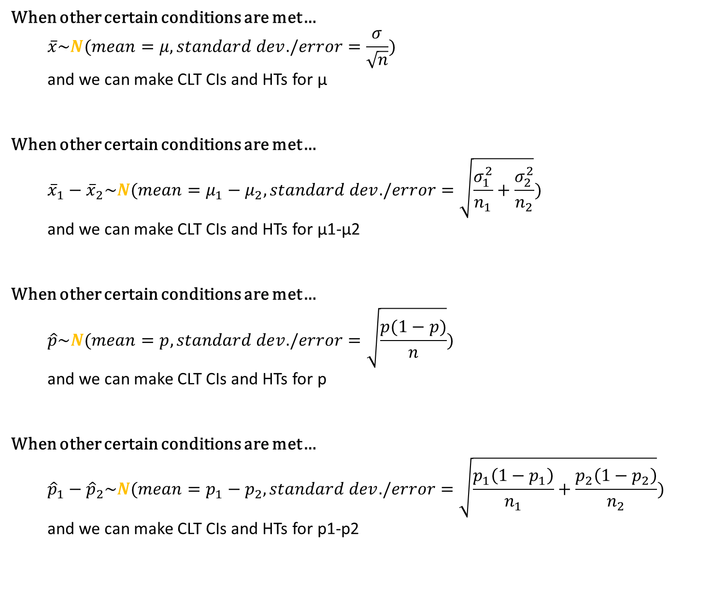
When other certain conditions are met…
  $$\overline{x}\sim N(mean=μ,standard dev./error=\frac{σ}{\sqrt{n}})$$
  and we can make CLT CIs and HTs for μ
When other certain conditions are met…
  $${\overline{x}}_{1}−{\overline{x}}_{2}\sim N(mean=μ_{1}−μ_{2},standard dev./error=\sqrt{\frac{σ_{1}^{2}}{n_{1}}+\frac{σ_{2}^{2}}{n_{2}}})$$
  and we can make CLT CIs and HTs for μ1-μ2
When other certain conditions are met…
  $$\hat{p}\sim N(mean=p,standard dev./error=\sqrt{\frac{p(1−p)}{n}})$$
  and we can make CLT CIs and HTs for p
When other certain conditions are met…
  $${\hat{p}}_{1}−{\hat{p}}_{2}\sim N(mean=p_{1}−p_{2},standard dev./error=\sqrt{\frac{p_{1}\left(1−p_{1}\right)}{n_{1}}+\frac{p_{2}\left(1−p_{2}\right)}{n_{2}}})$$
  and we can make CLT CIs and HTs for p1-p2
Be sure to refresh on properties of Normal Distributions!
(Deck 2.3)
What are some properties of normal distributions that others don’t have?

Slide 21
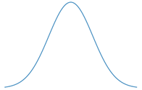
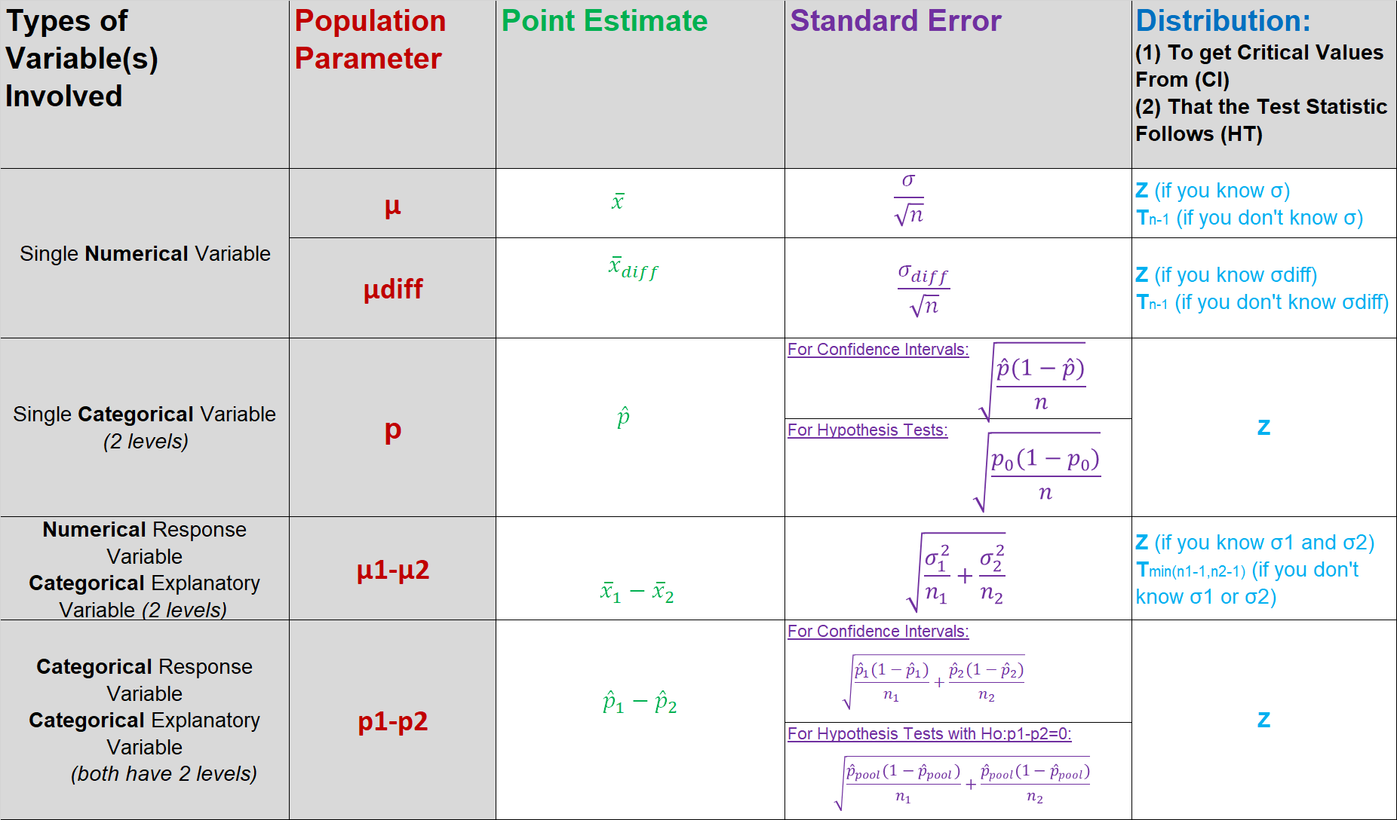
Central Limit Theorem
Confidence Interval for Population Parameter
$$(point estimate)±\left(crit. value\right)SE$$
When CLT
conditions
are met.

Slide 22


Central Limit Theorem
Hypothesis Testing for Population Parameter
$$Ho:pop. param=null value$$
$$Ha:pop. param(≠or>or<)null value$$
$$Test−Stat=\frac{\left(point estimate\right)−null value}{SE}$$
When CLT
conditions
are met.

Slide 23

Which test to use? Calculating p-values appropriately

Slide 24
A group of researchers want to see if there is a difference in the average SAT score between the oldest and youngest child in a family. 20 families with just two children were sampled and the SAT score was recorded for each child. The test statistic for this test is T = -1.8. What is the p-value?
Clicker question
0.01 < p-value < 0.025
0.025 < p-value < 0.05
0.05 < p-value < 0.10
0.10 < p-value < 0.20

Slide 25
A group of researchers want to see if there is a difference in the average SAT score between the oldest and youngest child in a family. 20 families with just two children were sampled and the SAT score was recorded for each child. The test statistic for this test is T = -1.8. What is the p-value?
Clicker question
0.01 < p-value < 0.025
0.025 < p-value < 0.05
0.05 < p-value < 0.10
0.10 < p-value < 0.20
Population Parameter of Interest:
μdiff (Paired Means Test) OR
μoldest – μyoungest (Independent Means Test)?

Slide 26
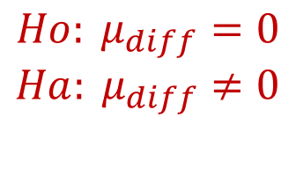
A group of researchers want to see if there is a difference in the average SAT score between the oldest and youngest child in a family. 20 families with just two children were sampled and the SAT score was recorded for each child. The test statistic for this test is T = -1.8. What is the p-value?
Clicker question
0.01 < p-value < 0.025
0.025 < p-value < 0.05
0.05 < p-value < 0.10
0.10 < p-value < 0.20
Population Parameter of Interest:
μdiff (Paired Means Test)
$$Ho: μ_{diff}=0$$
$$Ha: μ_{diff}≠0$$
T = -1.8
Degrees of Freedom = n-1 = 20-1 = 19

Slide 27
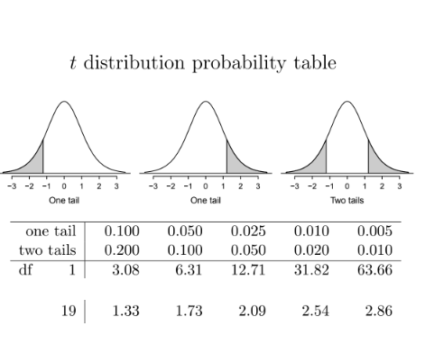
A group of researchers want to see if there is a difference in the average SAT score between the oldest and youngest child in a family. 20 families with just two children were sampled and the SAT score was recorded for each child. The test statistic for this test is T = -1.8. What is the p-value?
Clicker question
0.01 < p-value < 0.025
0.025 < p-value < 0.05
0.05 < p-value < 0.10
0.10 < p-value < 0.20
Population Parameter of Interest:
μdiff (Paired Means Test)
$$Ho: μ_{diff}=0$$
$$Ha: μ_{diff}≠0$$
T = -1.8
Degrees of Freedom = n-1 = 20-1 = 19
Take absolute value.
*

Slide 28
A group of researchers want to see if there is a difference in the average SAT score between the oldest and youngest child in a family. 20 families with just two children were sampled and the SAT score was recorded for each child. The test statistic for this test is T = -1.8. What is the p-value?
Clicker question
0.01 < p-value < 0.025
0.025 < p-value < 0.05
0.05 < p-value < 0.10
0.10 < p-value < 0.20
Population Parameter of Interest:
μdiff (Paired Means Test)
$$Ho: μ_{diff}=0$$
$$Ha: μ_{diff}≠0$$
T = -1.8
Degrees of Freedom = n-1 = 20-1 = 19
Take absolute value.
*

Slide 29
A group of researchers want to see if there is a difference in the average SAT score between the oldest and youngest child in a family. 20 families with just two children were sampled and the SAT score was recorded for each child. The test statistic for this test is T = -1.8. What is the p-value?
Clicker question
0.01 < p-value < 0.025
0.025 < p-value < 0.05
0.05 < p-value < 0.10
0.10 < p-value < 0.20
Population Parameter of Interest:
μdiff (Paired Means Test)
$$Ho: μ_{diff}=0$$
$$Ha: μ_{diff}≠0$$
Two-tailed test = two tails in t-table
T = -1.8
Degrees of Freedom = n-1 = 20-1 = 19
Take absolute value.
*

Slide 30

Which test to use? Calculating p-values appropriately

Slide 31
A group of researchers want to see if the average SAT score of first-born children is higher than that of last-born children. 10 first-born children were sampled and 10 last-born children were sampled. The test statistic for this test is T = -1.8. What is the p-value?
Clicker question
0.01 < p-value < 0.025
0.025 < p-value < 0.05
0.05 < p-value < 0.10
0.10 < p-value < 0.20

Slide 32
A group of researchers want to see if the average SAT score of first-born children is higher than that of last-born children. 10 first-born children were sampled and 10 last-born children were sampled. The test statistic for this test is T = -1.8. What is the p-value?
Clicker question
0.01 < p-value < 0.025
0.025 < p-value < 0.05
0.05 < p-value < 0.10
0.10 < p-value < 0.20
Population Parameter of Interest:
μdiff (Paired Means Test) OR
μoldest – μyoungest (Independent Means Test)?

Slide 33
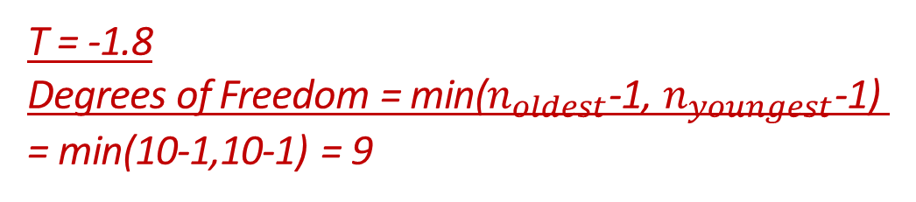
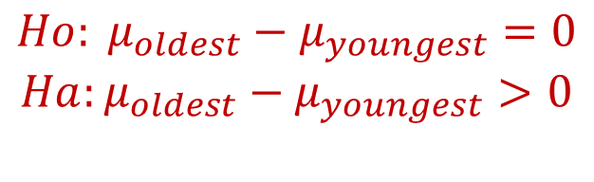
A group of researchers want to see if the average SAT score of first-born children is higher than that of last-born children. 10 first-born children were sampled and 10 last-born children were sampled. The test statistic for this test is T = -1.8. What is the p-value?
Clicker question
0.01 < p-value < 0.025
0.025 < p-value < 0.05
0.05 < p-value < 0.10
0.10 < p-value < 0.20
Population Parameter of Interest:
μoldest – μyoungest (Independent Means Test)
$$Ho: μ_{oldest}−μ_{youngest}=0$$
$$Ha:μ_{oldest}−μ_{youngest}>0$$
T = -1.8
Degrees of Freedom = min($n_{oldest}$-1, $n_{youngest}$-1)
= min(10-1,10-1) = 9

Slide 34
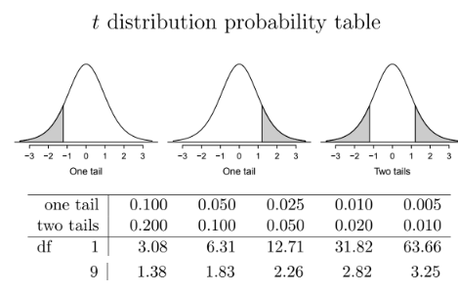
A group of researchers want to see if the average SAT score of first-born children is higher than that of last-born children. 10 first-born children were sampled and 10 last-born children were sampled. The test statistic for this test is T = -1.8. What is the p-value?
Clicker question
0.01 < p-value < 0.025
0.025 < p-value < 0.05
0.05 < p-value < 0.10
0.10 < p-value < 0.20
Population Parameter of Interest:
μoldest – μyoungest (Independent Means Test)
$$Ho: μ_{oldest}−μ_{youngest}=0$$
$$Ha:μ_{oldest}−μ_{youngest}>0$$
T = -1.8
Degrees of Freedom = min($n_{oldest}$-1, $n_{youngest}$-1)
= min(10-1,10-1) = 9
Take absolute value.

Slide 35
A group of researchers want to see if the average SAT score of first-born children is higher than that of last-born children. 10 first-born children were sampled and 10 last-born children were sampled. The test statistic for this test is T = -1.8. What is the p-value?
Clicker question
0.01 < p-value < 0.025
0.025 < p-value < 0.05
0.05 < p-value < 0.10
0.10 < p-value < 0.20
Population Parameter of Interest:
μoldest – μyoungest (Independent Means Test)
$$Ho: μ_{oldest}−μ_{youngest}=0$$
$$Ha:μ_{oldest}−μ_{youngest}>0$$
T = -1.8
Degrees of Freedom = min($n_{oldest}$-1, $n_{youngest}$-1)
= min(10-1,10-1) = 9
Take absolute value.
*

Slide 36
A group of researchers want to see if the average SAT score of first-born children is higher than that of last-born children. 10 first-born children were sampled and 10 last-born children were sampled. The test statistic for this test is T = -1.8. What is the p-value?
Clicker question
0.01 < p-value < 0.025
0.025 < p-value < 0.05
0.05 < p-value < 0.10
0.10 < p-value < 0.20
Population Parameter of Interest:
μoldest – μyoungest (Independent Means Test)
$$Ho: μ_{oldest}−μ_{youngest}=0$$
$$Ha:μ_{oldest}−μ_{youngest}>0$$
One-tailed test = one tail in t-table
T = -1.8
Degrees of Freedom = min($n_{oldest}$-1, $n_{youngest}$-1)
= min(10-1,10-1) = 9
Take absolute value.
*

Slide 37

What should you try if CLT conditions not met for hypothesis test for p?

Slide 38
What should you try if CLT conditions not met for hypothesis test for p?
Randomization testing!

Slide 39
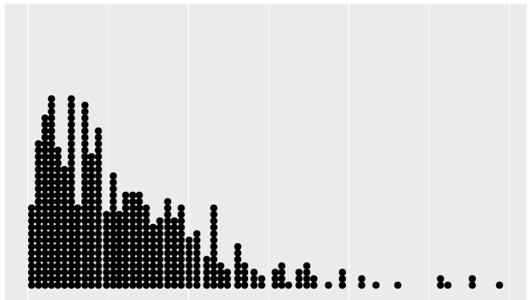
When designing a simulation that creates a randomization distribution, what is the main property the randomization distribution should have?

Slide 40
When designing a simulation that creates a randomization distribution, what is the main property the randomization distribution should have?
Should be roughly centered at the null value.
Assumes Ho.
We would expect the null value.

Slide 41
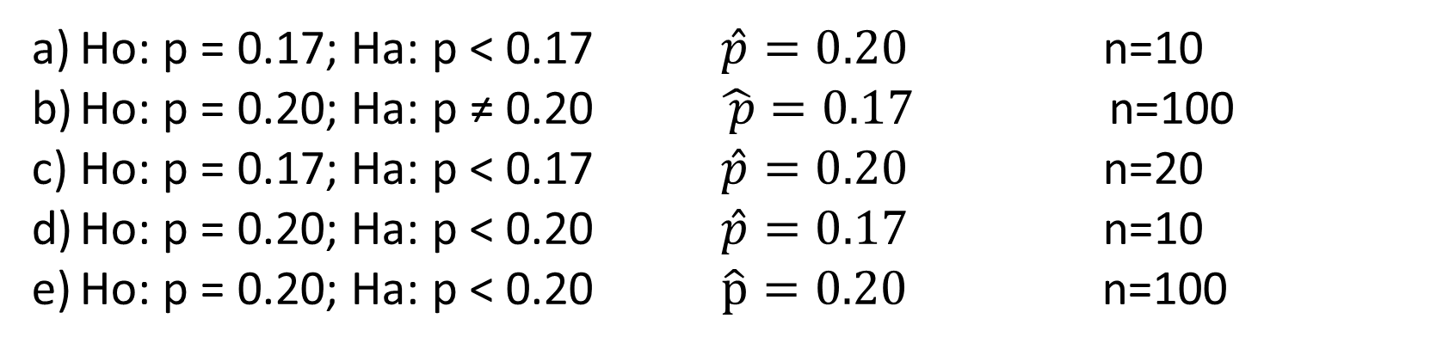
A researcher has set up the following randomization test for p. What were her hypotheses, observed sample proportion, and sample size?
Clicker question
Randomization Test for p
Place 100 chips in a bag, 20 red and 80 green.
Draw 10 chips from the bag with replacement.
Note the proportion of the 10 chips that were red and plot it in the randomization distribution.
Repeat (2) and (3) many times.
In the randomization distribution find the proportion of simulations where the sample proportion was 17% or less.
Ho: p = 0.17; Ha: p < 0.17 $\hat{p}=0.20$ n=10
Ho: p = 0.20; Ha: p ≠ 0.20 $\hat{ p}=0.17$ n=100
Ho: p = 0.17; Ha: p < 0.17 $\hat{p}=0.20$ n=20
Ho: p = 0.20; Ha: p < 0.20 $\hat{p}=0.17$ n=10
Ho: p = 0.20; Ha: p < 0.20 $\hat{p}=0.20$ n=100

Slide 42
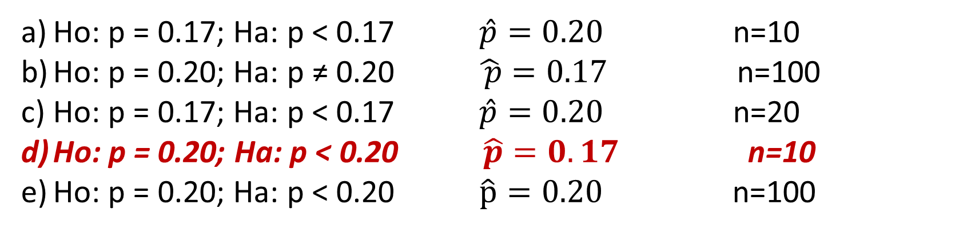
A researcher has set up the following randomization test for p. What were her hypotheses, observed sample proportion, and sample size?
Clicker question
Randomization Test for p
Place 100 chips in a bag, 20 red and 80 green.
Draw 10 chips from the bag with replacement.
Note the proportion of the 10 chips that were red and plot it in the randomization distribution.
Repeat (2) and (3) many times.
In the randomization distribution find the proportion of simulations where the sample proportion was 17% or less.
Ho: p = 0.17; Ha: p < 0.17 $\hat{p}=0.20$ n=10
Ho: p = 0.20; Ha: p ≠ 0.20 $\hat{ p}=0.17$ n=100
Ho: p = 0.17; Ha: p < 0.17 $\hat{p}=0.20$ n=20
Ho: p = 0.20; Ha: p < 0.20 $\hat{p}=0.17$ n=10
Ho: p = 0.20; Ha: p < 0.20 $\hat{p}=0.20$ n=100

Slide 43
A researcher has set up the following randomization test for p. What were her hypotheses, observed sample proportion, and sample size?
Clicker question
Randomization Test for p
Place 100 chips in a bag, 20 red and 80 green.
Draw 10 chips from the bag with replacement.
Note the proportion of the 10 chips that were red and plot it in the randomization distribution.
Repeat (2) and (3) many times.
In the randomization distribution find the proportion of simulations where the sample proportion was 17% or less.
Ho: p = 0.20; Ha: p < 0.20 $\hat{p}=0.17$ n=10

Slide 44
A researcher has set up the following randomization test for p. What were her hypotheses, observed sample proportion, and sample size?
Clicker question
Randomization Test for p
Place 100 chips in a bag, 20 red and 80 green.
Draw 10 chips from the bag with replacement.
Note the proportion of the 10 chips that were red and plot it in the randomization distribution.
Repeat (2) and (3) many times.
In the randomization distribution find the proportion of simulations where the sample proportion was 17% or less.
Randomization Dist
Assumes Ho: p=0.20
0.20
Simulated Sample Proportions
Ho: p = 0.20; Ha: p < 0.20 $\hat{p}=0.17$ n=10

Slide 45
A researcher has set up the following randomization test for p. What were her hypotheses, observed sample proportion, and sample size?
Clicker question
Randomization Test for p
Place 100 chips in a bag, 20 red and 80 green.
Draw 10 chips from the bag with replacement.
Note the proportion of the 10 chips that were red and plot it in the randomization distribution.
Repeat (2) and (3) many times.
In the randomization distribution find the proportion of simulations where the sample proportion was 17% or less.
Randomization Dist
Assumes Ho: p=0.20
0.20
Simulated Sample Proportions
Of size n=10
Ho: p = 0.20; Ha: p < 0.20 $\hat{p}=0.17$ n=10

Slide 46
A researcher has set up the following randomization test for p. What were her hypotheses, observed sample proportion, and sample size?
Clicker question
Randomization Test for p
Place 100 chips in a bag, 20 red and 80 green.
Draw 10 chips from the bag with replacement.
Note the proportion of the 10 chips that were red and plot it in the randomization distribution.
Repeat (2) and (3) many times.
In the randomization distribution find the proportion of simulations where the sample proportion was 17% or less.
Randomization Dist
Assumes Ho: p=0.20
0.20
Simulated Sample Proportions
Of size n=10
Ho: p = 0.20; Ha: p < 0.20 $\hat{p}=0.17$ n=10

Slide 47
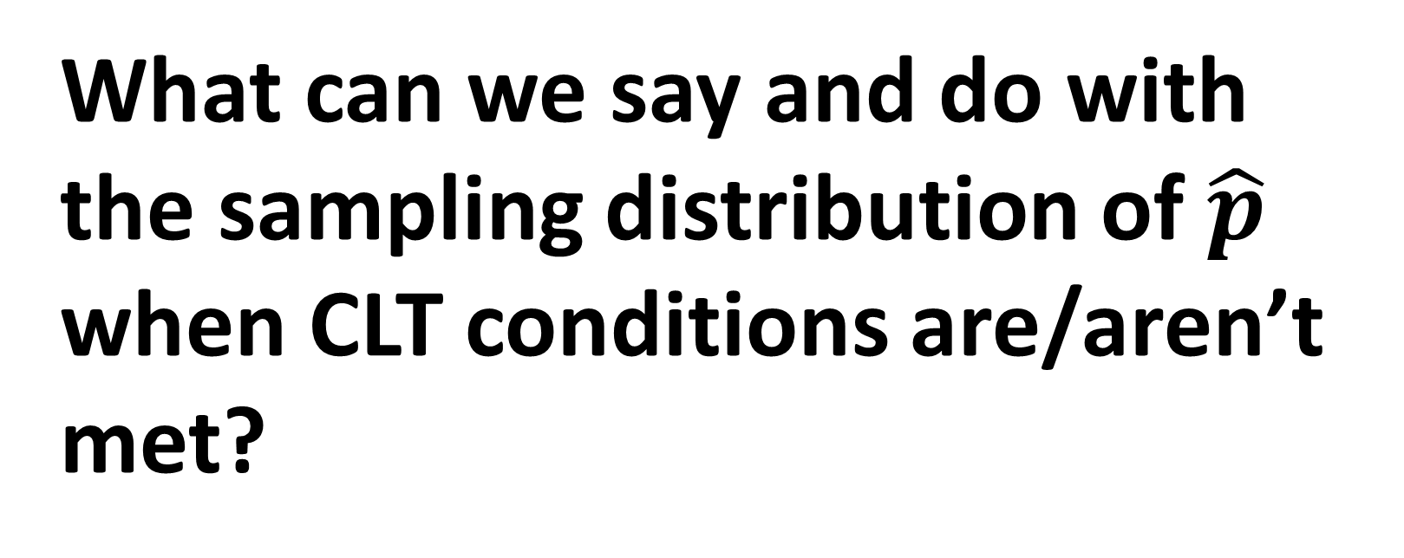
What can we say and do with the sampling distribution of $\hat{p}$ when CLT conditions are/aren’t met?

Slide 48
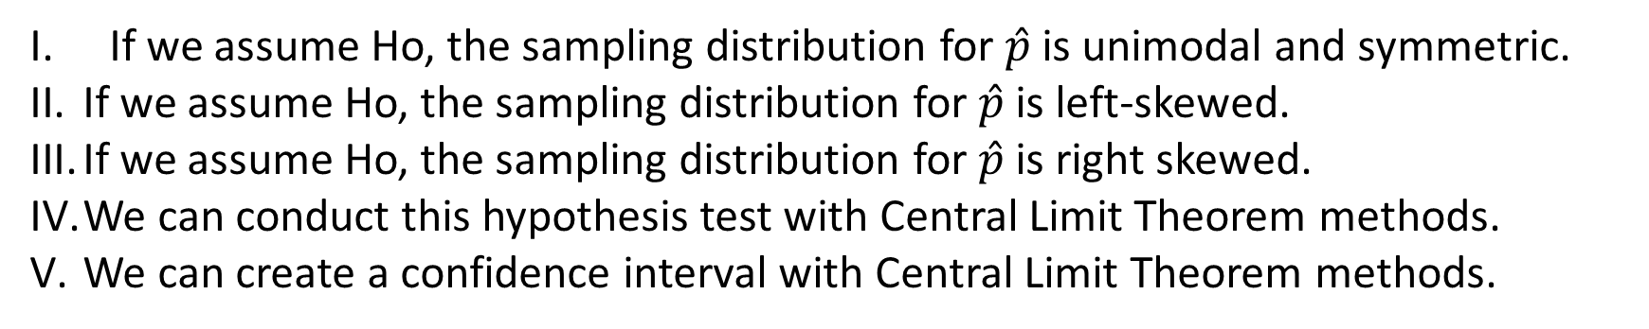
We would like to test if the proportion of Duke students that are only-children is larger than 0.10. We collected a random sample of 60 Duke students and found that 0.25 are only-children. Which of the following is true?
Clicker question
If we assume Ho, the sampling distribution for $\hat{p}$ is unimodal and symmetric.
If we assume Ho, the sampling distribution for $\hat{p}$ is left-skewed.
If we assume Ho, the sampling distribution for $\hat{p}$ is right skewed.
We can conduct this hypothesis test with Central Limit Theorem methods.
We can create a confidence interval with Central Limit Theorem methods.
I, IV, and V
II
III
III and V
I and V

Slide 49
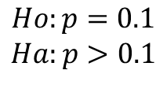
We would like to test if the proportion of Duke students that are only-children is larger than 0.10. We collected a random sample of 60 Duke students and found that 0.25 are only-children. Which of the following is true?
Clicker question
If we assume Ho, the sampling distribution for $\hat{p}$ is unimodal and symmetric.
If we assume Ho, the sampling distribution for $\hat{p}$ is left-skewed.
If we assume Ho, the sampling distribution for $\hat{p}$ is right skewed.
We can conduct this hypothesis test with Central Limit Theorem methods.
We can create a confidence interval with Central Limit Theorem methods.
I, IV, and V
II
III
III and V
I and V
Hypothesis Test
$$Ho:p=0.1$$
$$Ha:p>0.1$$

Slide 50
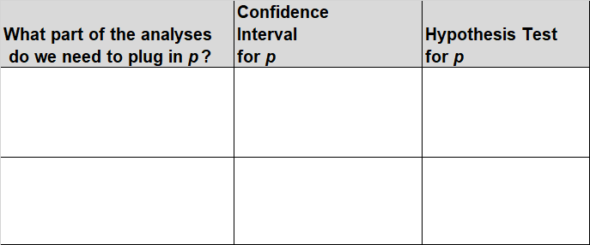
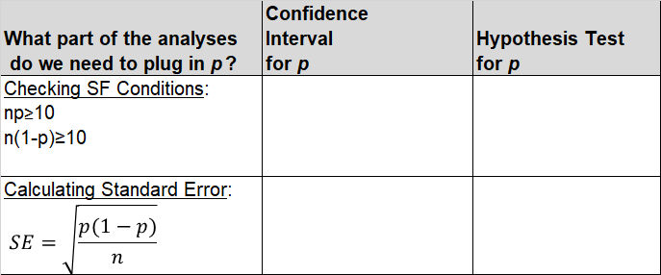
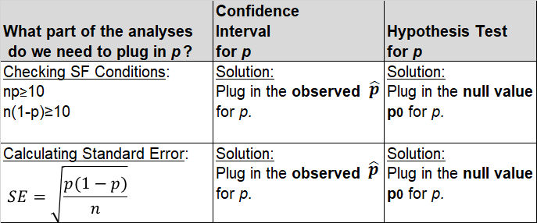
🔍
CI vs. HT determines observed vs. expected counts / proportions
Problem: In Confidence intervals and Hypothesis Testing, we don’t know what p is but we need to plug it in in two parts of the analyses.

Slide 51

We would like to test if the proportion of Duke students that are only-children is larger than 0.10. We collected a random sample of 60 Duke students and found that 0.25 are only-children. Which of the following is true?
Clicker question
If we assume Ho, the sampling distribution for $\hat{p}$ is unimodal and symmetric.
If we assume Ho, the sampling distribution for $\hat{p}$ is left-skewed.
If we assume Ho, the sampling distribution for $\hat{p}$ is right skewed.
We can conduct this hypothesis test with Central Limit Theorem methods.
We can create a confidence interval with Central Limit Theorem methods.
CLT Conditions for HT:
Independence:
  Random sampling
  N=60<10% of Duke Students
SF-Conditions:
  $np_{0}=60\left(0.10\right)<10$
  $n(1−p_{0})=60\left(1−0.10\right)≥10$
I, IV, and V
II
III
III and V
I and V
Hypothesis Test
$$Ho:p=0.1$$
$$Ha:p>0.1$$

Slide 52
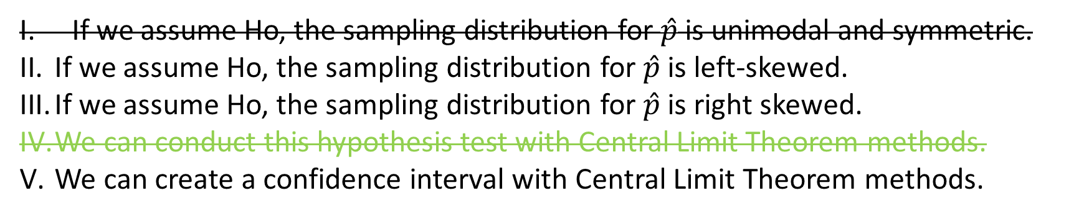
We would like to test if the proportion of Duke students that are only-children is larger than 0.10. We collected a random sample of 60 Duke students and found that 0.25 are only-children. Which of the following is true?
Clicker question
If we assume Ho, the sampling distribution for $\hat{p}$ is unimodal and symmetric.
If we assume Ho, the sampling distribution for $\hat{p}$ is left-skewed.
If we assume Ho, the sampling distribution for $\hat{p}$ is right skewed.
We can conduct this hypothesis test with Central Limit Theorem methods.
We can create a confidence interval with Central Limit Theorem methods.
CLT Conditions for HT:
Independence:
  Random sampling
  N=60<10% of Duke Students
SF-Conditions:
  $np_{0}=60\left(0.10\right)<10$
  $n(1−p_{0})=60\left(1−0.10\right)≥10$
SF conditions not met for a hypothesis test.
…can’t use CLT hypothesis test
…sampling distribution (that assumes Ho) is not normal (symmetric/unimodal)
I, IV, and V
II
III
III and V
I and V
Hypothesis Test
$$Ho:p=0.1$$
$$Ha:p>0.1$$

Slide 53
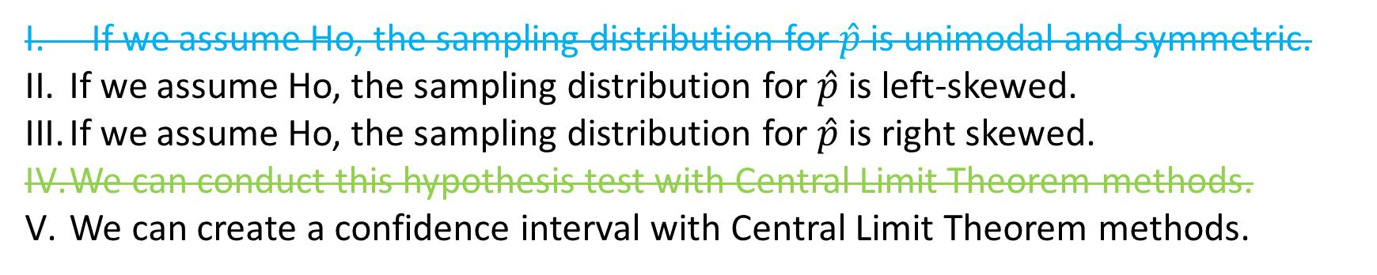
We would like to test if the proportion of Duke students that are only-children is larger than 0.10. We collected a random sample of 60 Duke students and found that 0.25 are only-children. Which of the following is true?
Clicker question
If we assume Ho, the sampling distribution for $\hat{p}$ is unimodal and symmetric.
If we assume Ho, the sampling distribution for $\hat{p}$ is left-skewed.
If we assume Ho, the sampling distribution for $\hat{p}$ is right skewed.
We can conduct this hypothesis test with Central Limit Theorem methods.
We can create a confidence interval with Central Limit Theorem methods.
CLT Conditions for HT:
Independence:
  Random sampling
  N=60<10% of Duke Students
SF-Conditions:
  $np_{0}=60\left(0.10\right)<10$
  $n(1−p_{0})=60\left(1−0.10\right)≥10$
SF conditions not met for a hypothesis test.
…can’t use CLT hypothesis test
…sampling distribution (that assumes Ho) is not normal (symmetric/unimodal)
I, IV, and V
II
III
III and V
I and V
Hypothesis Test
$$Ho:p=0.1$$
$$Ha:p>0.1$$

Slide 54
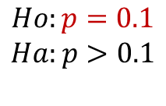
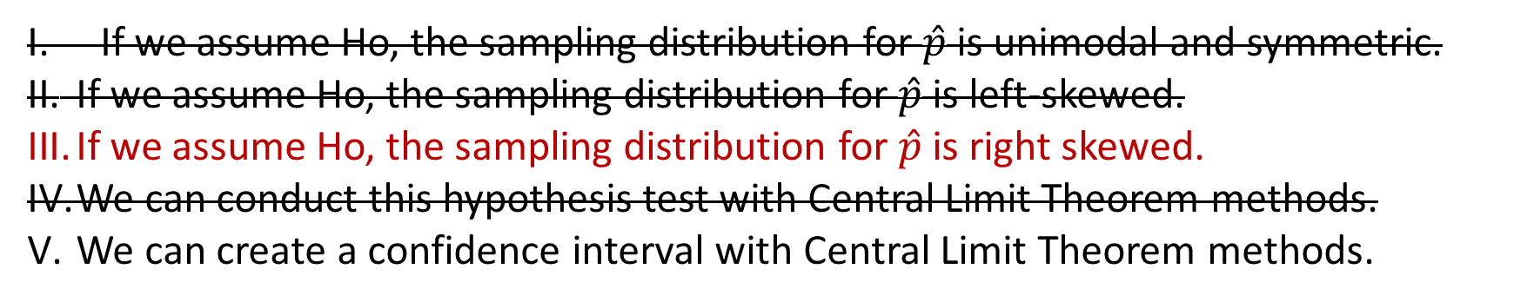
We would like to test if the proportion of Duke students that are only-children is larger than 0.10. We collected a random sample of 60 Duke students and found that 0.25 are only-children. Which of the following is true?
Clicker question
If we assume Ho, the sampling distribution for $\hat{p}$ is unimodal and symmetric.
If we assume Ho, the sampling distribution for $\hat{p}$ is left-skewed.
If we assume Ho, the sampling distribution for $\hat{p}$ is right skewed.
We can conduct this hypothesis test with Central Limit Theorem methods.
We can create a confidence interval with Central Limit Theorem methods.
CLT Conditions for HT:
Independence:
  Random sampling
  N=60<10% of Duke Students
SF-Conditions:
  $np_{0}=60\left(0.10\right)<10$
  $n(1−p_{0})=60\left(1−0.10\right)≥10$
Peak of the sampling distribution (that assumes Ho) is centered at p=0.1
Not symmetric/unimodal
Natural boundaries are [0,1]… peak close to 0.
I, IV, and V
II
III
III and V
I and V
Hypothesis Test
$$Ho:p=0.1$$
$$Ha:p>0.1$$

Slide 55

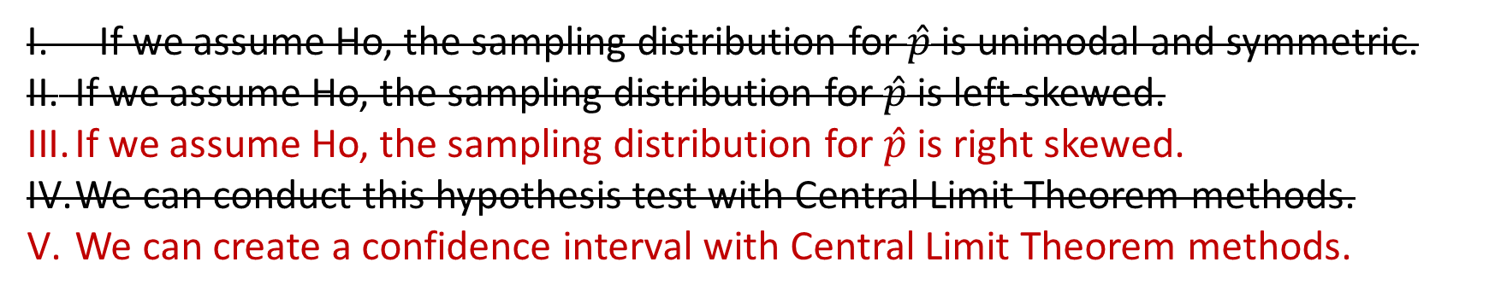
We would like to test if the proportion of Duke students that are only-children is larger than 0.10. We collected a random sample of 60 Duke students and found that 0.25 are only-children. Which of the following is true?
Clicker question
If we assume Ho, the sampling distribution for $\hat{p}$ is unimodal and symmetric.
If we assume Ho, the sampling distribution for $\hat{p}$ is left-skewed.
If we assume Ho, the sampling distribution for $\hat{p}$ is right skewed.
We can conduct this hypothesis test with Central Limit Theorem methods.
We can create a confidence interval with Central Limit Theorem methods.
CLT Conditions for CI:
Independence:
  Random sampling
  N=60<10% of Duke Students
SF-Conditions:
  $n\hat{p}=60\left(0.25\right)≥10$
  $n(1−\hat{p})=60\left(1−0.25\right)≥10$
I, IV, and V
II
III
III and V
I and V

Slide 56
What are the two ways we can make an error in a HT?
What are the two ways we can make the right decision in a HT?

Slide 57

Probability of Errors in a HT
Probability of Correct Decisions in a HT
What are the names for these errors/correct decisions?
How are they affected by:
Sample size
Effect Size
Significance Level

Slide 58
Suppose we were to decrease the sample size and increase the effect size at the same time. What happens to the following?
Clicker question
Probability of rejecting the null hypothesis given that the null hypothesis is actually true.
Probability of rejecting the null hypothesis given that the alternative hypothesis is actually true.
We don’t know what happens to either I and II.
I and II stay both stay same.
I and II both decrease.
I stays the same, II decreases.
I stays the same, and we don’t know what happens to II.

Slide 59
Suppose we were to decrease the sample size and increase the effect size at the same time. What happens to the following?
Clicker question
Probability of rejecting the null hypothesis given that the null hypothesis is actually true. α=P(Type 1 Error) = Significance Level
Probability of rejecting the null hypothesis given that the alternative hypothesis is actually true. Power
We don’t know what happens to either I and II.
I and II stay both stay same.
I and II both decrease.
I stays the same, II decreases.
I stays the same, and we don’t know what happens to II.

Slide 60
Suppose we were to decrease the sample size and increase the effect size at the same time. What happens to the following?
Clicker question
Probability of rejecting the null hypothesis given that the null hypothesis is actually true. α = P(Type 1 Error)=Significance Level (Stays the same… the researcher pre-selects α, not affected by sample size or effect size changes.)
Probability of rejecting the null hypothesis given that the alternative hypothesis is actually true. Power
We don’t know what happens to either I and II.
I and II stay both stay same.
I and II both decrease.
I stays the same, II decreases.
I stays the same, and we don’t know what happens to II.

Slide 61
Suppose we were to decrease the sample size and increase the effect size at the same time. What happens to the following?
Clicker question
Probability of rejecting the null hypothesis given that the null hypothesis is actually true. α = P(Type 1 Error)= Significance Level (Stays the same… the researcher pre-selects α, not affected by sample size or effect size changes.)
Probability of rejecting the null hypothesis given that the alternative hypothesis is actually true. Power (Power decreases when sample size decreases. Power increases when sample size increases…. so they have counterbalancing effects…. Not sure
We don’t know what happens to either I and II.
I and II stay both stay same.
I and II both decrease.
I stays the same, II decreases.
I stays the same, and we don’t know what happens to II.

Slide 62
Suppose we were to increase the sample size. What happens to the following?
Clicker question
Probability of failing to reject the null hypothesis given that the alternative hypothesis is actually true.
The complement of I.
Both increase.
I increases, II decreases.
I decreases, II increases.
We don’t know what happens to either.

Slide 63
Suppose we were to increase the sample size. What happens to the following?
Clicker question
Probability of failing to reject the null hypothesis given that the alternative hypothesis is actually true. β = P(Type 2 Error Rate)
The complement of I. 1- β =Power
Both increase.
I increases, II decreases.
I decreases, II increases.
We don’t know what happens to either.

Slide 64
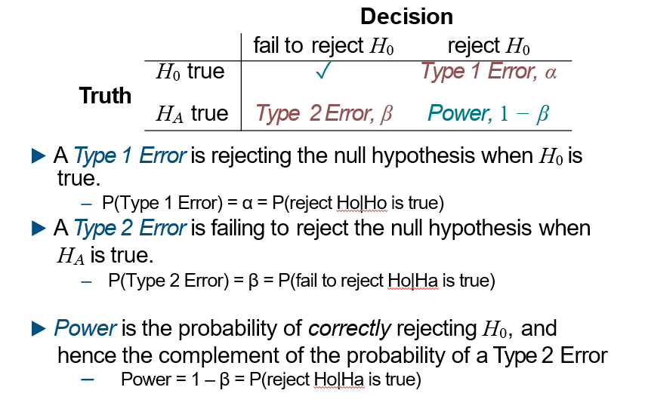

Slide 65
There are several ways to increase power (and hence decrease P(Type 2 error), β:
Achieving desired power
Increase the sample size.
Decrease the standard deviation of the sample, which is equivalent to increasing the sample size (it will decrease the standard error). With a smaller s we have a better chance of distinguishing the null value from the observed point estimate. This is difﬁcult to ensure but cautious measurement process and limiting the population so that it is more homogenous may help.
Increase α, which will make it more likely to reject H₀ (but note that this has the side effect of increasing the Type 1 error rate).
Consider a larger effect size. If the true mean of the population is in the alternative hypothesis but close to the null value, it will be harder to detect a difference.

Slide 66

Completing a
Chi-Squared Test
of Independence

Slide 67
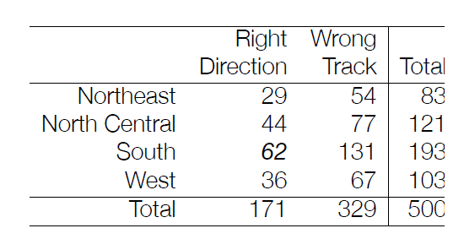
Assuming that region and opinion on whether the country is headed on the right track are independent, what is the expected number of Southerners that think the country is on the wrong track?
Clicker question
131
131/500 = 0.26
(329∙193)/500 = 127
193/500 = 0.39
(131-127)^2 / 127

Slide 68
Assuming that region and opinion on whether the country is headed on the right track are independent, what is the expected number of Southerners that think the country is on the wrong track?
Clicker question
131
131/500 = 0.26
(329∙193)/500 = 127
193/500 = 0.39
(131-127)^2 / 127
Expected Count for a Cell
in Chi-Squared Independence Test=
(row total)*(column total)/(sample total)

Slide 69
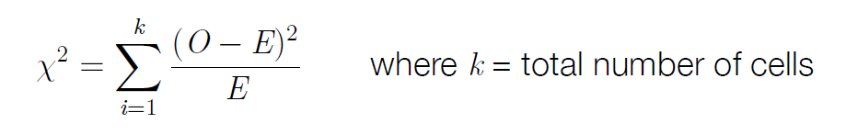
What is the test statistic for:
Chi-Squared Goodness of Fit Test?
Chi-Squared Independence Test?
It’s the same calculation!
2

Slide 70
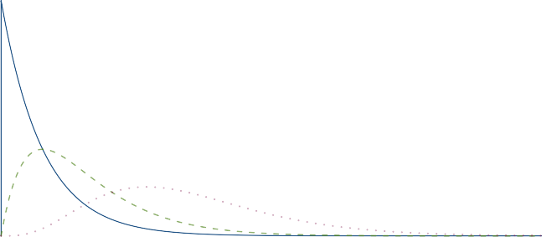
The χ² distribution has just one parameter, degrees of freedom (df), which inﬂuences the shape, center, and spread of the distribution.
▶ For χ² GOF test: df = k − 1
▶ For χ² independence test: df = (R − 1) × (C − 1)
# of levels of the one categorical variable
# of levels of categorical variable 1 (or Rows in the counts table)
# of levels of categorical variable 2 (or Columns in the counts table)
Degrees of Freedom
2
4
9
0
5
10
15
20
25

Slide 71
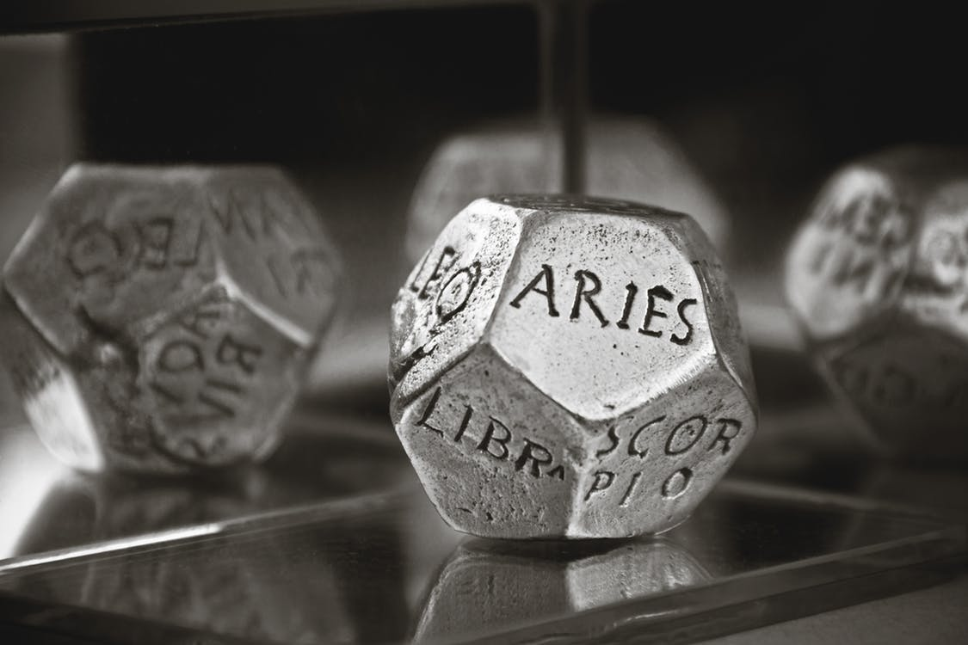
Figuring out which test to use.

Slide 72
Fortune magazine collected the zodiac signs of 256 CEOs of the largest 400 companies. We are interested to know if you are equally likely to be a CEO for all zodiac signs. What test would we use?
Achieving desired power
Clicker question
ANOVA
Single Proportion Hypothesis Test
Two Proportion Hypothesis Test
Chi-Squared Goodness of Fit Test
Chi-Squared Independence Test

Slide 73
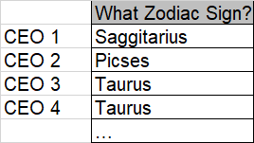
Fortune magazine collected the zodiac signs of 256 CEOs of the largest 400 companies. We are interested to know if you are equally likely to be a CEO for all zodiac signs. What test would we use?
Achieving desired power
Clicker question
ANOVA
Single Proportion Hypothesis Test
Two Proportion Hypothesis Test
Chi-Squared Goodness of Fit Test
Chi-Squared Independence Test
One Categorical Variable with >2 (12 levels)
Ho: The CEO zodiac sign data follows the distribution where all zodiac signs are equally likely.
Ha: The CEO zodiac sign data doesn’t follow the distribution where all zodiac signs are equally likely.

Slide 74
Figuring out which test to use.

Slide 75
Fortune magazine collected the zodiac signs of 256 CEOs of the largest 400 companies as well as the zodiac signs for all non-CEOs. We are interested to know if there’s a difference in the proportions of Sagittarius’ and Aquarius’ that are CEOs.
Achieving desired power
Clicker question
ANOVA
Single Proportion Hypothesis Test
Two Proportion Hypothesis Test
Chi-Squared Goodness of Fit Test
Chi-Squared Independence Test

Slide 76
Fortune magazine collected the zodiac signs of 256 CEOs of the largest 400 companies as well as the zodiac signs for all non-CEOs. We are interested to know if there’s a difference in the proportions of Sagittarius’ and Aquarius’ that are CEOs.
Achieving desired power
Clicker question
ANOVA
Single Proportion Hypothesis Test
Two Proportion Hypothesis Test
Chi-Squared Goodness of Fit Test
Chi-Squared Independence Test
Categorical Variable (2 levels): CEO/Not CEO
Categorical Variable (2 levels): Sagittarius/Aquarius (ignore the other signs)

Slide 77
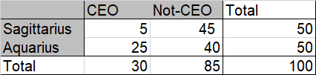
Fortune magazine collected the zodiac signs of 256 CEOs of the largest 400 companies as well as the zodiac signs for all non-CEOs. We are interested to know if there’s a difference in the proportions of Sagittarius’ and Aquarius’ that are CEOs.(Assume random sampling used). We want to make a confidence interval and hypothesis test. Which of the following methods are most appropriate?
Achieving desired power
Clicker question
CI – CLT methods, HT – Randomization Testing
CI – Randomization Testing, HT – CLT Methods
CI – CLT methods, HT – CLT Methods
CI – Bootstrap methods, HT – CLT Methods
CI – Bootstrap methods, HT – Randomization Testing

Slide 78
Fortune magazine collected the zodiac signs of 256 CEOs of the largest 400 companies as well as the zodiac signs for all non-CEOs. We are interested to know if there’s a difference in the proportions of Sagittarius’ and Aquarius’ that are CEOs.(Assume random sampling used). We want to make a confidence interval and hypothesis test. Which of the following methods are most appropriate?
Achieving desired power
Clicker question
CI – CLT methods, HT – Randomization Testing
CI – Randomization Testing, HT – CLT Methods
CI – CLT methods, HT – CLT Methods
CI – Bootstrap methods, HT – CLT Methods
CI – Bootstrap methods, HT – Randomization Testing

Slide 79
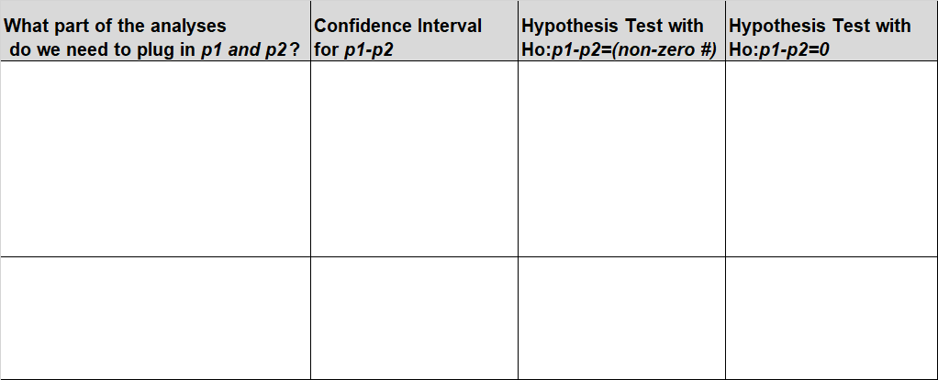
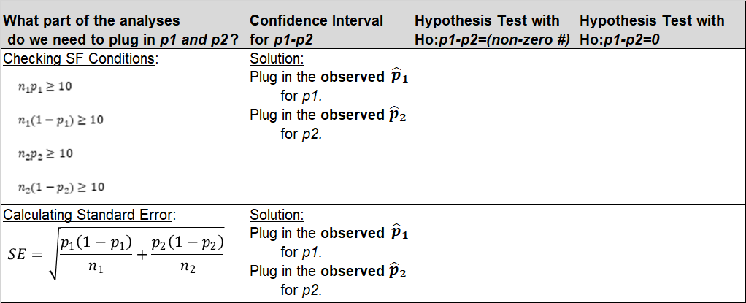
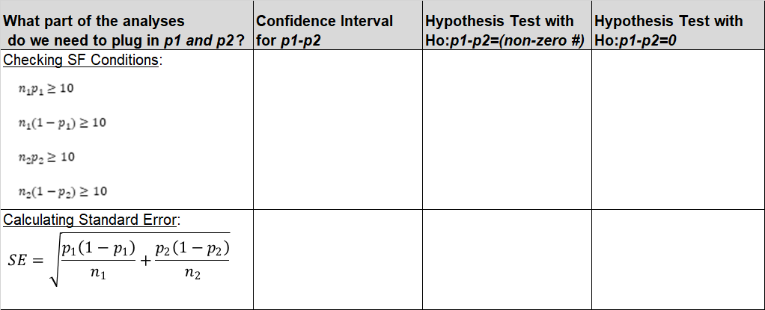
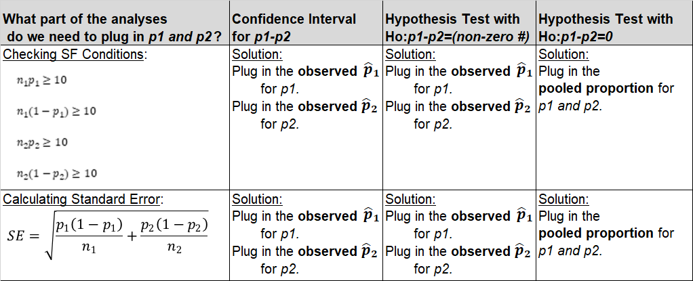
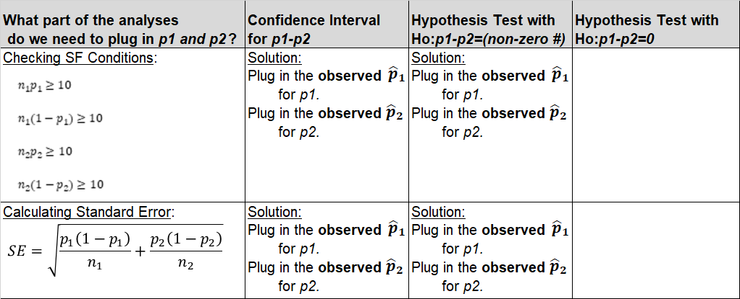
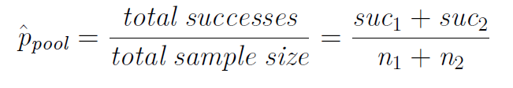
For HT where H₀ : p₁ = p₂, pool!
Expected proportion of success for both groups when
H₀ : p₁ = p₂ is deﬁned as the pooled proportion:
3

Slide 80
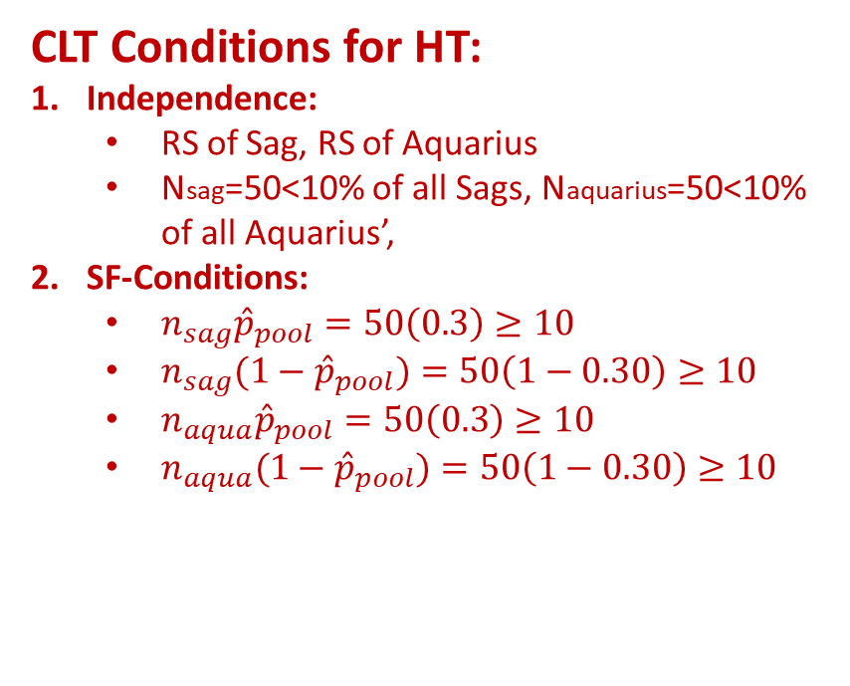
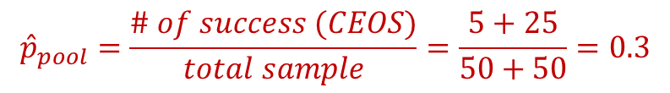
Fortune magazine collected the zodiac signs of 256 CEOs of the largest 400 companies as well as the zodiac signs for all non-CEOs. We are interested to know if there’s a difference in the proportions of Sagittarius’ and Aquarius’ that are CEOs.(Assume random sampling used). We want to make a confidence interval and hypothesis test. Which of the following methods are most appropriate?
Achieving desired power
Clicker question
CI – CLT methods, HT – Randomization Testing
CI – Randomization Testing, HT – CLT Methods
CI – CLT methods, HT – CLT Methods
CI – Bootstrap methods, HT – CLT Methods
CI – Bootstrap methods, HT – Randomization Testing
CLT Conditions for HT:
Independence:
  RS of Sag, RS of Aquarius
  Nsag=50<10% of all Sags, Naquarius=50<10% of all Aquarius’,
SF-Conditions:
  $n_{sag}{\hat{p}}_{pool}=50\left(0.3\right)≥10$
  $n_{sag}(1−{\hat{p}}_{pool})=50\left(1−0.30\right)≥10$
  $n_{aqua}{\hat{p}}_{pool}=50\left(0.3\right)≥10$
  $n_{aqua}(1−{\hat{p}}_{pool})=50\left(1−0.30\right)≥10$
$${\hat{p}}_{pool}=\frac{\# of success (CEOS)}{total sample}=\frac{5+25}{50+50}=0.3$$

Slide 81
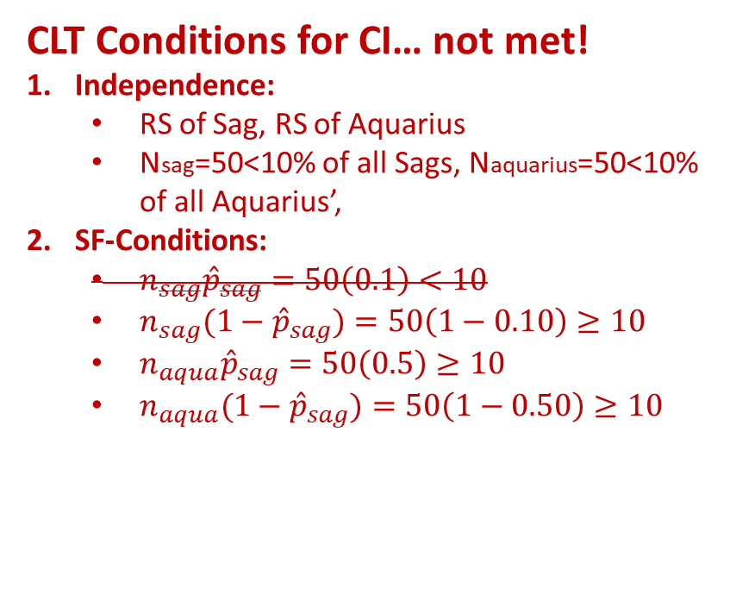


Fortune magazine collected the zodiac signs of 256 CEOs of the largest 400 companies as well as the zodiac signs for all non-CEOs. We are interested to know if there’s a difference in the proportions of Sagittarius’ and Aquarius’ that are CEOs.(Assume random sampling used). We want to make a confidence interval and hypothesis test. Which of the following methods are most appropriate?
Achieving desired power
Clicker question
CI – CLT methods, HT – Randomization Testing
CI – Randomization Testing, HT – CLT Methods
CI – CLT methods, HT – CLT Methods
CI – Bootstrap methods, HT – CLT Methods
CI – Bootstrap methods, HT – Randomization Testing
CLT Conditions for CI… not met!
Independence:
  RS of Sag, RS of Aquarius
  Nsag=50<10% of all Sags, Naquarius=50<10% of all Aquarius’,
SF-Conditions:
  $n_{sag}{\hat{p}}_{sag}=50\left(0.1\right)<10$
  $n_{sag}(1−{\hat{p}}_{sag})=50\left(1−0.10\right)≥10$
  $n_{aqua}{\hat{p}}_{sag}=50\left(0.5\right)≥10$
  $n_{aqua}(1−{\hat{p}}_{sag})=50\left(1−0.50\right)≥10$
${\hat{p}}_{sag}=\frac{5}{50}=0.1$,
${\hat{p}}_{aqua}=\frac{25}{50}=0.5$,

Slide 82
Fortune magazine collected the zodiac signs of 256 CEOs of the largest 400 companies as well as their annual salary. We want to know if there’s an association between a CEO’s zodiac sign and their salary.
Achieving desired power
Clicker question
ANOVA
Single Proportion Hypothesis Test
Two Proportion Hypothesis Test
Chi-Squared Goodness of Fit Test
Chi-Squared Independence Test

Slide 83
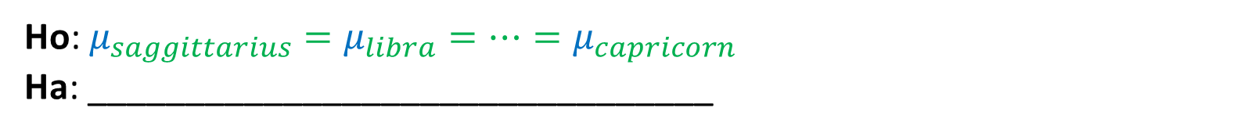
Fortune magazine collected the zodiac signs of 256 CEOs of the largest 400 companies as well as their annual salary. We want to know if there’s an association between a CEO’s zodiac sign and their annual salary.
Achieving desired power
Clicker question
ANOVA
Single Proportion Hypothesis Test
Two Proportion Hypothesis Test
Chi-Squared Goodness of Fit Test
Chi-Squared Independence Test
Categorical Explanatory Variable with >2 (12 levels)
One Numerical Response Variable
Ho: $μ_{saggittarius}=μ_{libra}=…=μ_{capricorn}$
Ha: ________________________________

Slide 84
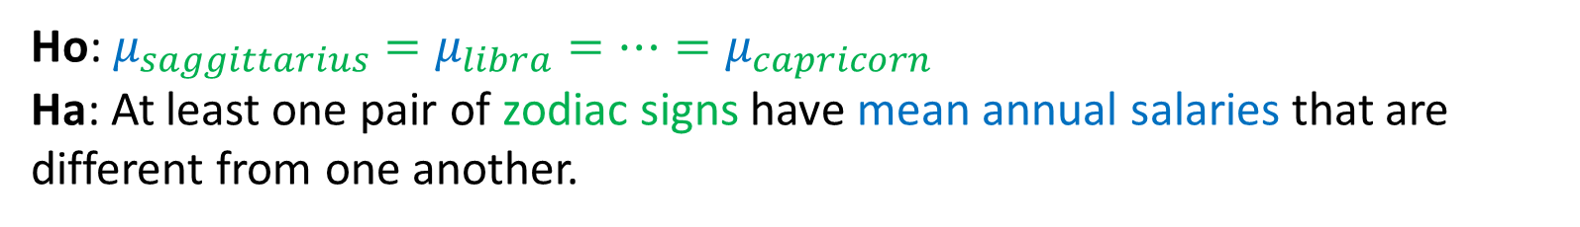
Fortune magazine collected the zodiac signs of 256 CEOs of the largest 400 companies as well as their annual salary. We want to know if there’s an association between a CEO’s zodiac sign and their annual salary.
Achieving desired power
Clicker question
ANOVA
Single Proportion Hypothesis Test
Two Proportion Hypothesis Test
Chi-Squared Goodness of Fit Test
Chi-Squared Independence Test
Categorical Explanatory Variable with >2 (12 levels)
One Numerical Response Variable
Ho: $μ_{saggittarius}=μ_{libra}=…=μ_{capricorn}$
Ha: At least one pair of zodiac signs have mean annual salaries that are different from one another.

Slide 85
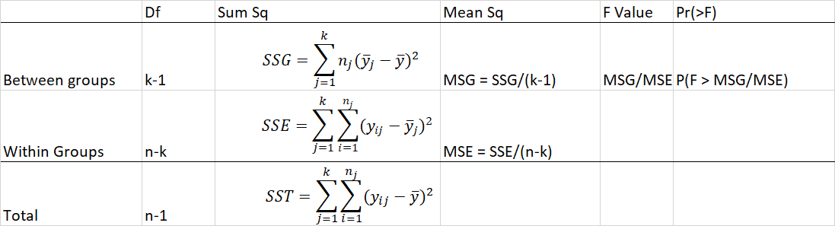
🔍 👫
Step 1a: Fill out the ANOVA table.
p-value
Test Statistic
k: # of groups; n: # of obs.
Step 1b: Evaluate the p-value to make a conclusion.
p-value<α: Reject Ho. There is sufficient evidence to suggest Ha.
p-value≥α: Fail to reject Ho. There is not sufficient evidence to suggest Ha.

Slide 86
Fortune magazine collected the zodiac signs of 256 CEOs of the largest 400 companies as well as their annual salary. We conducted an ANOVA and found there was sufficient evidence to suggest at least one of the pairs of zodiac signs had mean annual salaries that are different from one another. How many post-hoc tests would we need run to determine which of these pairs were different?
Achieving desired power
Clicker question
66
12
132
2

Slide 87
Fortune magazine collected the zodiac signs of 256 CEOs of the largest 400 companies as well as their annual salary. We conducted an ANOVA and found there was sufficient evidence to suggest at least one of the pairs of zodiac signs had mean annual salaries that are different from one another. How many post-hoc tests would we need run to determine which of these pairs were different?
Achieving desired power
Clicker question
66 = total number of pairs you can make out of k (12) levels = k(k-1)/2 = 12(11)/2
12
132
2

Slide 88
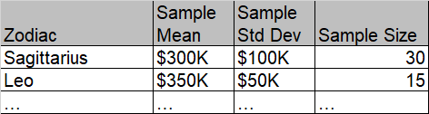
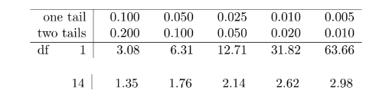

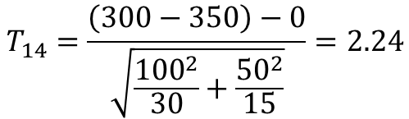
Fortune magazine collected the zodiac signs of 256 CEOs of the largest 400 companies as well as their annual salary. We conducted an ANOVA and found there was sufficient evidence to suggest at least one of the pairs of zodiac signs had mean annual salaries that are different from one another (at α=0.1). The test statistic and p-value for the post-hoc multiple comparison test that compares the salaries of Sagittarius and Leo CEOS is below. How many errors did we make in these calculations and conclusion?
Achieving desired power
Clicker question
0
1
2
3
4 or more
$$T_{14}=\frac{\left(300−350\right)−0}{\sqrt{\frac{{100}^{2}}{30}+\frac{{50}^{2}}{15}}}=2.24$$
$$0.01<p−value<0.025$$
Because p-value < 0.1, reject Ho.

Slide 89
Fortune magazine collected the zodiac signs of 256 CEOs of the largest 400 companies as well as their annual salary. We conducted an ANOVA and found there was sufficient evidence to suggest at least one of the pairs of zodiac signs had mean annual salaries that are different from one another (at α=0.1). The test statistic and p-value for the post-hoc multiple comparison test that compares the salaries of Sagittarius and Leo CEOS is below. How many errors did we make in these calculations and conclusion?
Achieving desired power
Clicker question
0
1
2
3
4 or more
$$T_{14}=\frac{\left(300−350\right)−0}{\sqrt{\frac{{100}^{2}}{30}+\frac{{50}^{2}}{15}}}=2.24$$
$$0.01<p−value<0.025$$
Because p-value < 0.1, reject Ho.

Slide 90


To identify which means are diﬀerent, use t-tests and the Bonferroni
correction
Things that are different for conducting one of the post-hoc multiple comparison tests (after ANOVA).
Things that are Different | Regular Independent Means Test (with null value =0) | Post-hoc (ANOVA Step 2) Multiple Pairwise Comparisons Tests (do this for each one)
Significance Level | $$α$$ | $$α^{∗}=\frac{α }{{k(k−1)}/2}$$
T-Statistics | $$T=\frac{\left({\overline{x}}_{a}−{\overline{x}}_{b}\right)−0}{\sqrt{\frac{s_{a}^{2}}{n_{a}}+\frac{s_{b}^{2}}{n_{b}}}}$$ | $$T=\frac{\left({\overline{x}}_{a}−{\overline{x}}_{b}\right)−0}{\sqrt{\frac{MSE}{n_{a}}+\frac{MSE}{n_{b}}}}$$
Degrees of Freedom to use in T-distribution | $df=min⁡(n_{a}−1,$ $n_{b}−1$) | $$df={df}_{E}=n−k$$ n=total number of observations k=# of groups
Ho: $μ_{a}−μ_{b}=0$
Ha: $μ_{a}−μ_{b}≠0$

Slide 91



Fortune magazine collected the zodiac signs of 256 CEOs of the largest 400 companies as well as their annual salary. We conducted an ANOVA and found there was sufficient evidence to suggest at least one of the pairs of zodiac signs had mean annual salaries that are different from one another (at α=0.1). The test statistic and p-value for the post-hoc multiple comparison test that compares the salaries of Sagittarius and Leo CEOS is below. How many errors did we make in these calculations and conclusion?
Achieving desired power
Clicker question
0
1
2
3
4 or more
$$T_{14}=\frac{\left(300−350\right)−0}{\sqrt{\frac{MSE}{30}+\frac{MSE}{15}}}=2.24$$
Came from the one-tailed in the t-table. Multiple comparison tests are two-tailed tests.
$$0.01<p−value<0.025$$
Ho: $μ_{saggittarius}−μ_{leo}=0$
Ha: $μ_{saggittarius}−μ_{leo}≠0$
Because p-value < 0.1, reject Ho.

Slide 92


Fortune magazine collected the zodiac signs of 256 CEOs of the largest 400 companies as well as their annual salary. We conducted an ANOVA and found there was sufficient evidence to suggest at least one of the pairs of zodiac signs had mean annual salaries that are different from one another (at α=0.1). The test statistic and p-value for the post-hoc multiple comparison test that compares the salaries of Sagittarius and Leo CEOS is below. How many errors did we make in these calculations and conclusion?
Achieving desired power
Clicker question
0
1
2
3
4 or more
$$T_{n−k}=\frac{\left(300−350\right)−0}{\sqrt{\frac{MSE}{30}+\frac{MSE}{15}}}=1.97$$
p-value=0.05
Ho: $μ_{saggittarius}−μ_{leo}=0$
Ha: $μ_{saggittarius}−μ_{leo}≠0$
Because p-value ≥ 0.1/[k(k-1)/2], reject Ho.
Use 2-tails in the t-table.

Slide 93

Fortune magazine collected the zodiac signs of 256 CEOs of the largest 400 companies as well as their annual salary. We conducted an ANOVA and found there was sufficient evidence to suggest at least one of the pairs of zodiac signs had mean annual salaries that are different from one another (at α=0.1). The test statistic and p-value for the post-hoc multiple comparison test that compares the salaries of Sagittarius and Leo CEOS is below. How many errors did we make in these calculations and conclusion?
Achieving desired power
Clicker question
0
1
2
3
4 or more
$$T_{256−12}=\frac{\left(300−350\right)−0}{\sqrt{\frac{MSE}{30}+\frac{MSE}{15}}}=1.97$$
p-value=0.05
Ho: $μ_{saggittarius}−μ_{leo}=0$
Ha: $μ_{saggittarius}−μ_{leo}≠0$
Because p-value ≥ 0.1/[12(12-1)/2], reject Ho.
Use 2-tails in the t-table.

Slide 94

Why/when would we want to make a bootstrap confidence interval?

Slide 95

The general structure for a CLT confidence interval for μ and a bootstrap confidence interval (SE method) for μ has three components (see below). How many of these components are the same for both a CLT confidence interval for μ (assume we don’t know σ) and a bootstrap confidence interval for μ (SE method) ?
Achieving desired power
Clicker question
$$\left( \right)±\left( \right)( )$$
1 2 3
0
1
2
3

Slide 96


Achieving desired power
Clicker question
The general structure for a CLT confidence interval for μ and a bootstrap confidence interval (SE method) for μ has three components (see below). How many of these components are the same for both a CLT confidence interval for μ (assume we don’t know σ) and a bootstrap confidence interval for μ (SE method) ?
$$\left( \right)±\left( \right)( )$$
1 2 3
0
1
2
3
CLT confidence interval for μ (don’t know σ)
$$\overline{x}±t_{n−1}\frac{s}{\sqrt{n}}$$
Bootstrap confidence interval for μ (SE Method)
$$\overline{x}±t_{n−1}σ_{boot}$$

Slide 97


Bootstrap Confidence Intervals
Step 1: Create the bootstrap distribution
aka:bootstrap sample
aka:bootstrap statistic
For comparison
6

Slide 98

Bootstrap Confidence Intervals
Step 2: Use the bootstrap distribution to create a confidence interval.
Percentile Method
  XX% bootstrap confidence interval =
  the cutoff values for the middle
  XX% of the bootstrap distribution
Standard Error Method
  XX% bootstrap confidence interval =
  point estimate ± t⋆SE_{boot}
Standard deviation of all the bootstrap statistics you calculated
When the point estimate is: $median, μ, μ_{diff},p$
degrees of freedom = n-1 (n = size of the original sample = each bootstrap sample)
area under t-distribution curve =(1-XX/100)% TWO TAILS.
6

Slide 99

Interpreting confidence intervals

Slide 100


Slide 102

Properties of Normal, T, Chi-Squared, and F distribution

Slide 103
The figure below shows three unimodal and symmetric curves. Which of the following is most plausible?
Clicker question

Slide 104
The figure below shows three unimodal and symmetric curves. Which of the following is most plausible?
Clicker question

Slide 105
▶ Calculating the necessary sample size for a CI of p with a given margin of error:
Option 1: If there is a previous study, use pˆ from that study
Option 2: If not, use pˆ = 0.5:
  if you don’t know any better, 50-50 is a good guess
  pˆ = 0.5 gives the most conservative estimate of the standard error, which gives the highest possible sample size

